Slide 1


Demo Salesforce Progress
Aslene OUAZE

Slide 2
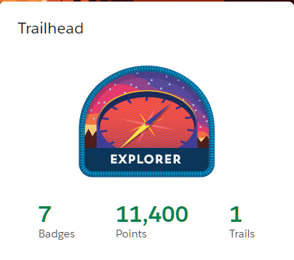
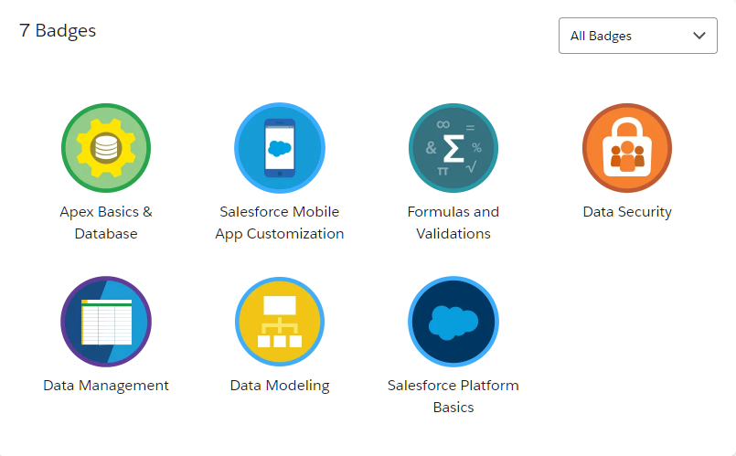

Slide 3
TABLE OF CONTENTS
01
02
Salesforce Platform Basics
Developer Beginner

Slide 4


01
Salesforce Platform Basics

Slide 5
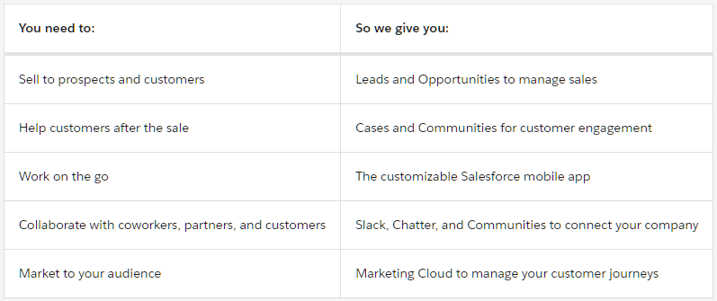
Basic Concepts
Salesforce is a highly customizable advanced CRM

Slide 6
Databases in Salesforce
Provides quick access to specific information
Application includes a set of objects
Objects include a set of records (data/values of the object)
Records include a set of fields
An instance of an application is called an Org

Slide 7
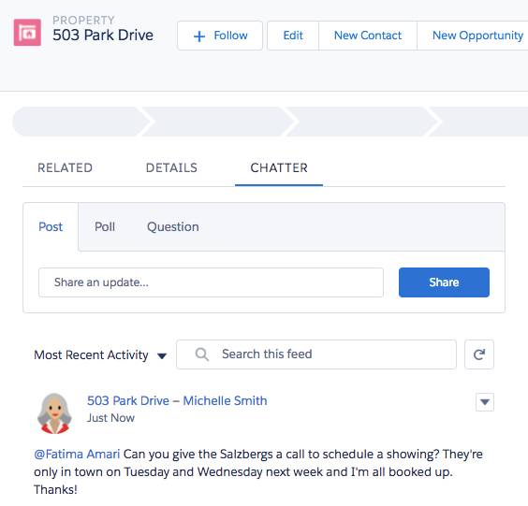
High Impact, Low Effort
The platform goal is to make big changes with minimal effort
The platform goal is to solve mistakes that impact the buyer
This can be done by chatter feed tracking where users can comment and collaborate on a record

Slide 8
Usecases
HR departement can use Salesforce to: - List job opening - Store applicants for each job - Automate reminders for hiring managers - Track employees’ time off

Slide 9
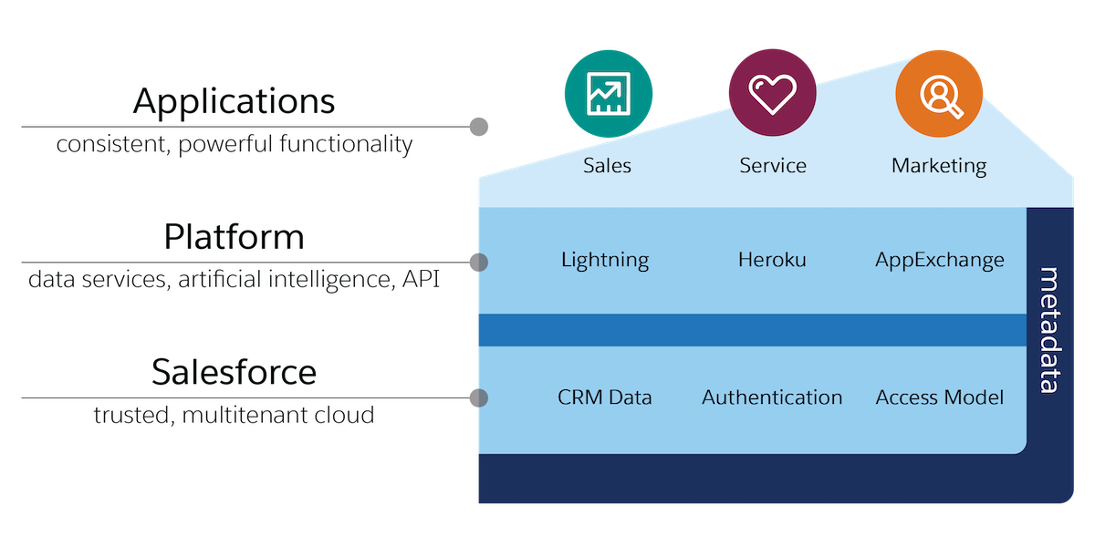
Architecture

Slide 10
Architecture
The architecture mainly focuses on : - Trust => security / transparent services ( keeping sensitive data in the org) - Multitenant cloud => no software installs + ressource sharing between all users ( same computing power …) - Meta Data - API => allows the software to connect and exchange information

Slide 11
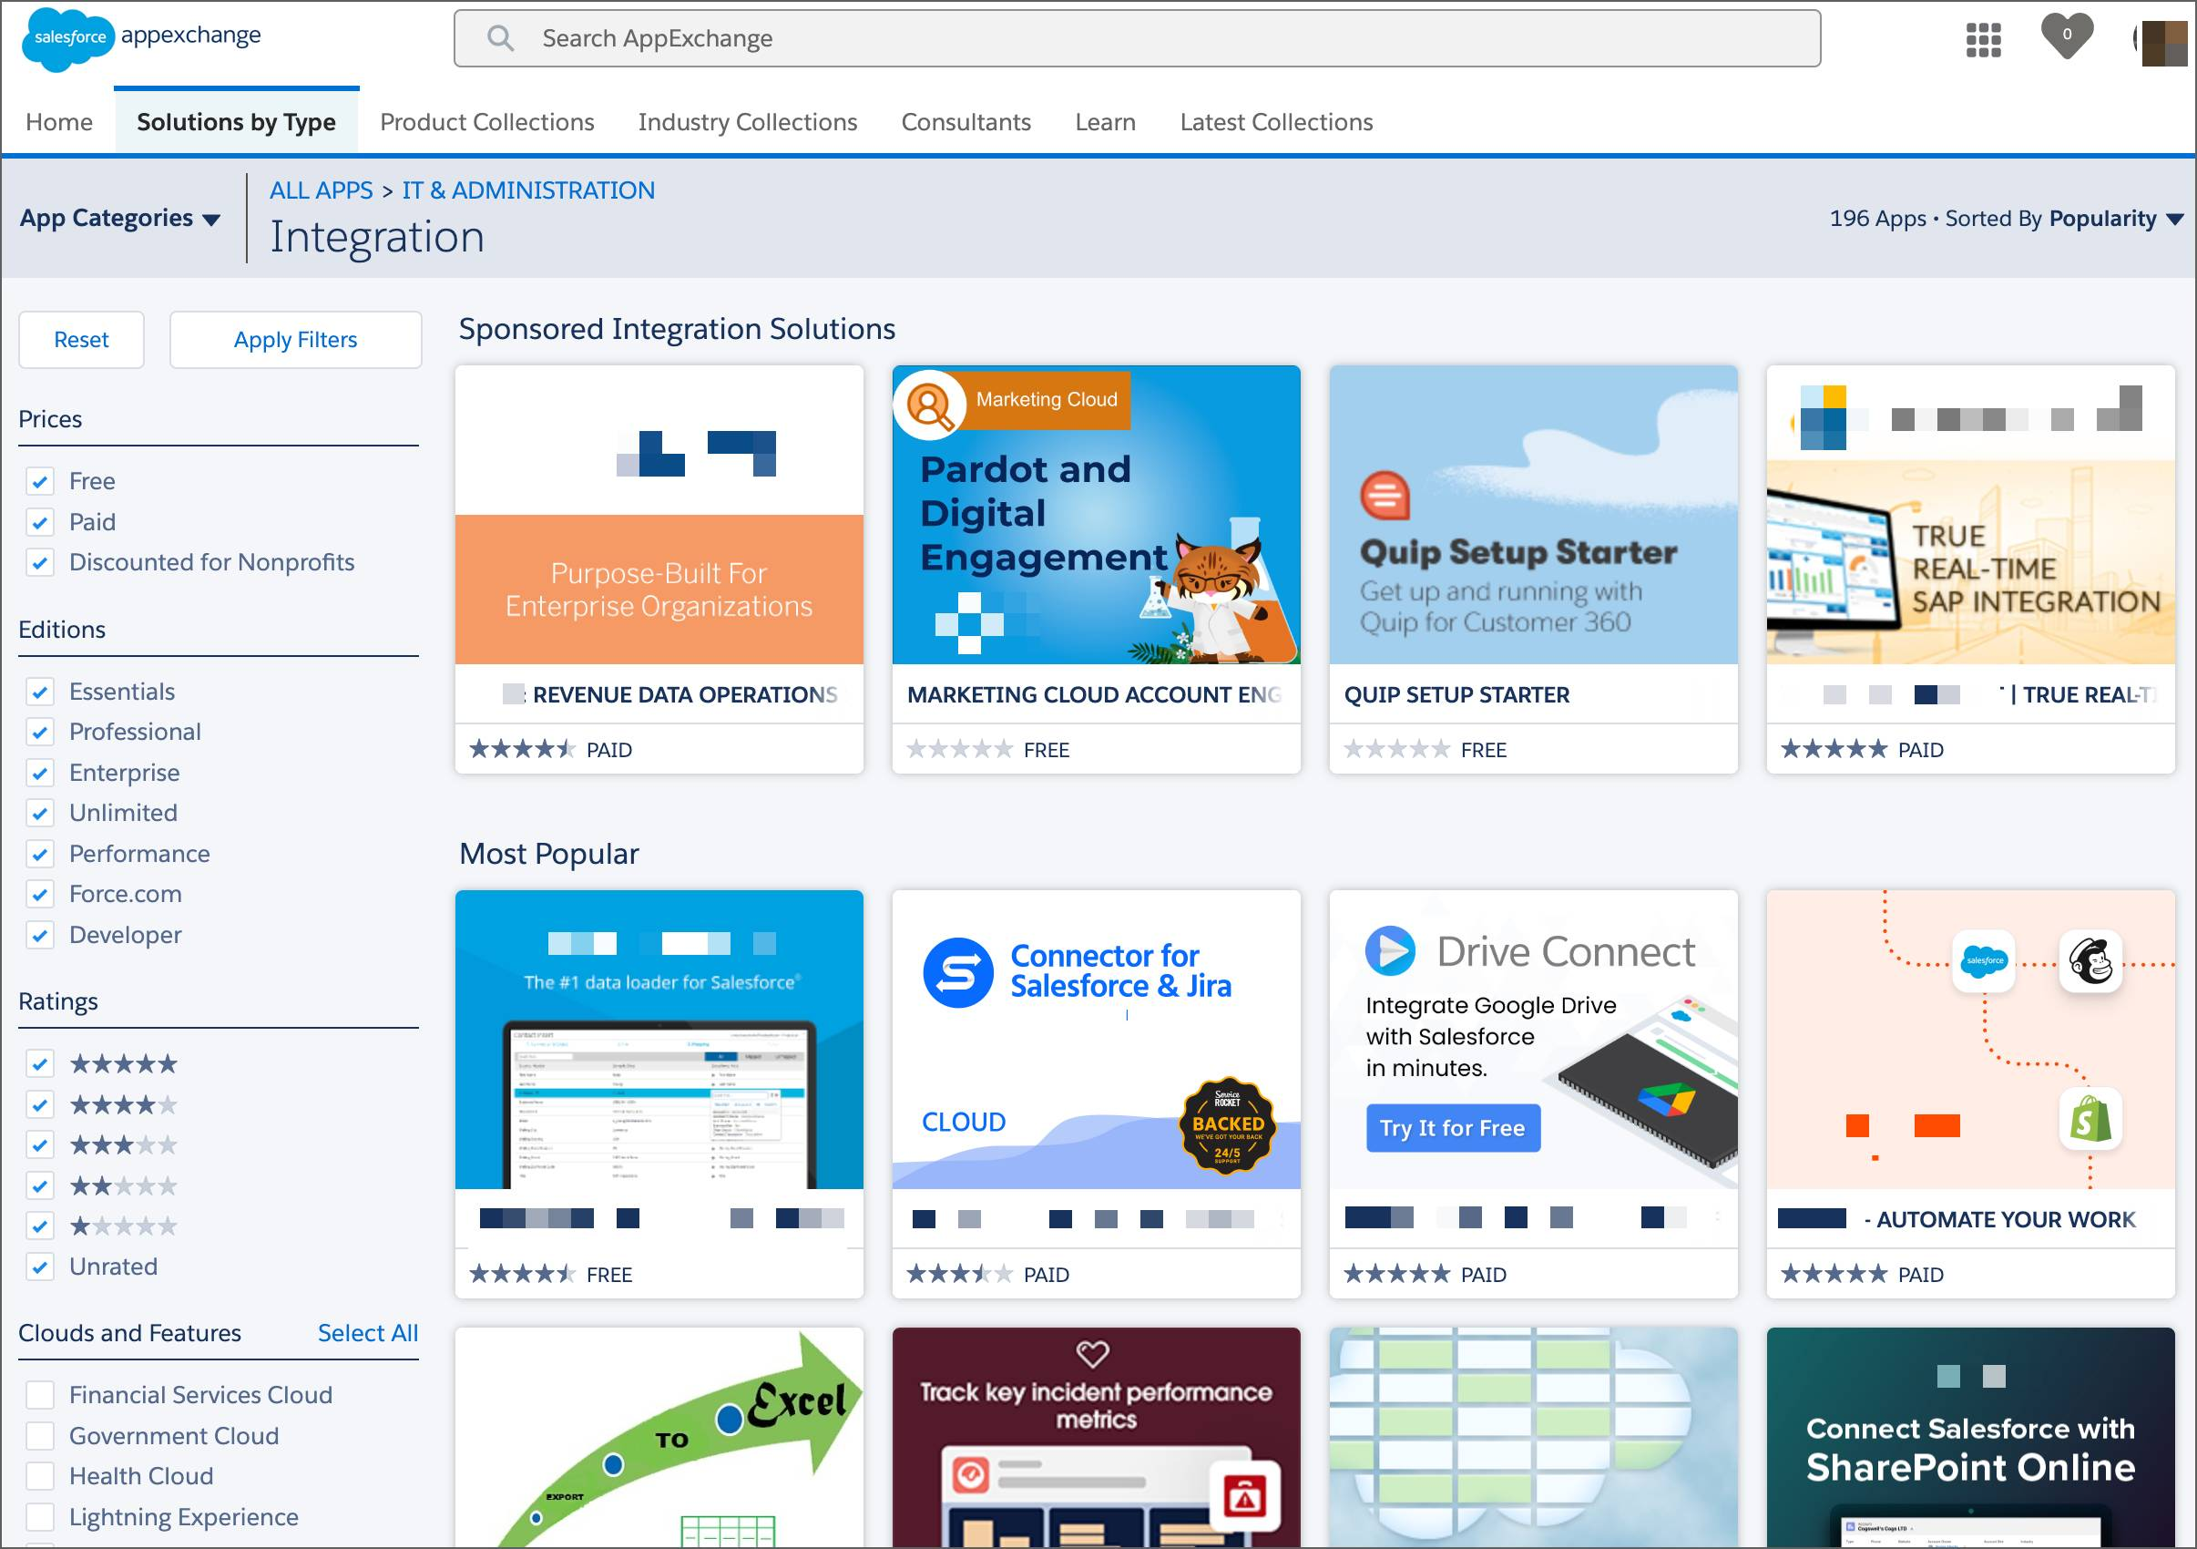
App Exchange
Its the app store of Salesforce where the user can add any application/extension to his app/ org .

Slide 12

02
Developer Beginner

Slide 13

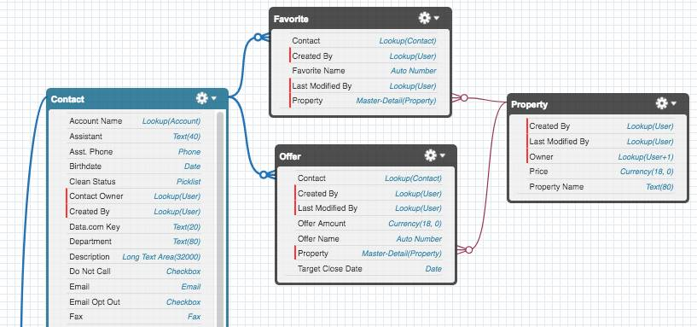
Data Modeling
Multiple objects create a whole schema and its accessible and editable via the schema builder in the setup menu of the org,

Slide 14
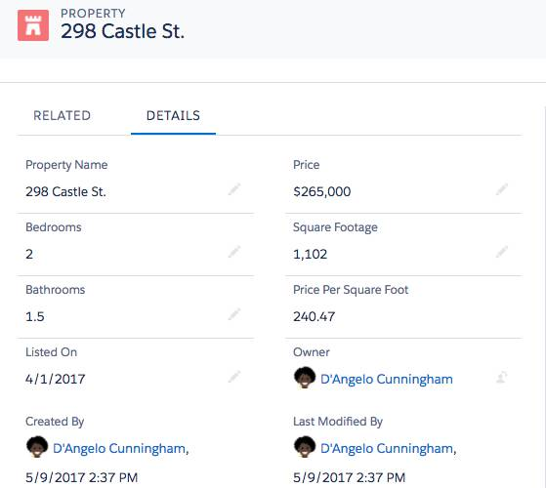
Data Modeling
The U/I is generated automatically upon creating a new object

Slide 15
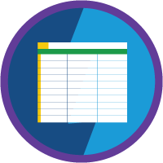
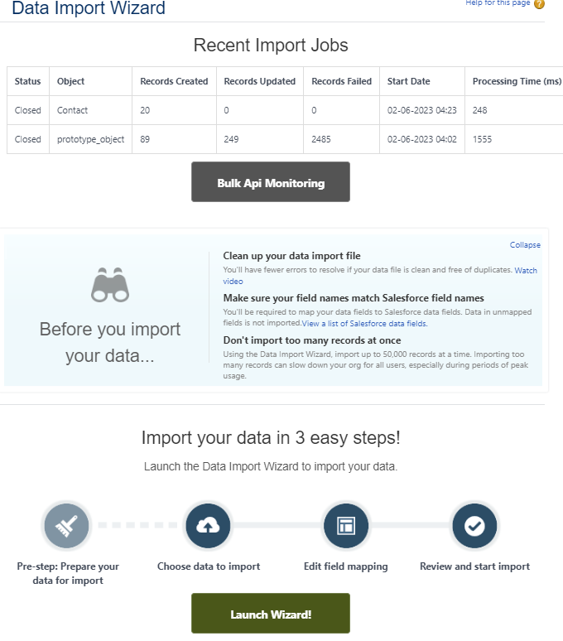
Data Mangement
Through the Data import wizard we can import spreadsheets ( CSV, xsls…) directly to our database.

Slide 16
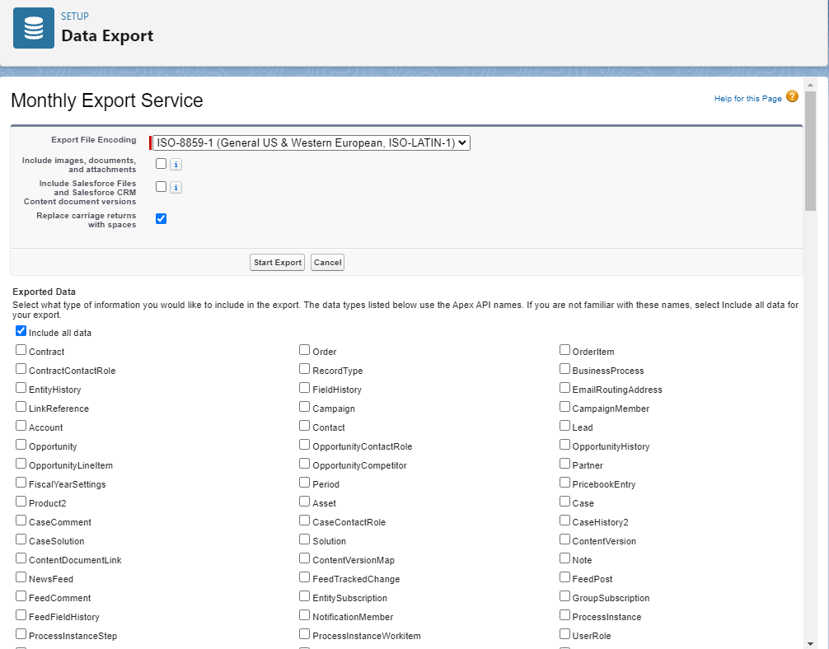
Data Mangement
Through the Data export wizard we can export our database into spreadsheets ( CSV, xsls…)

Slide 17

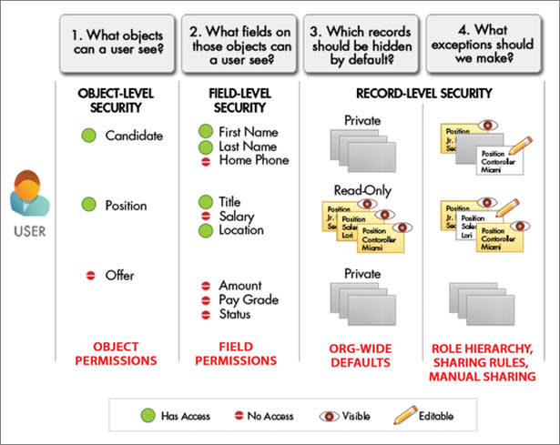
Data Security

Slide 18

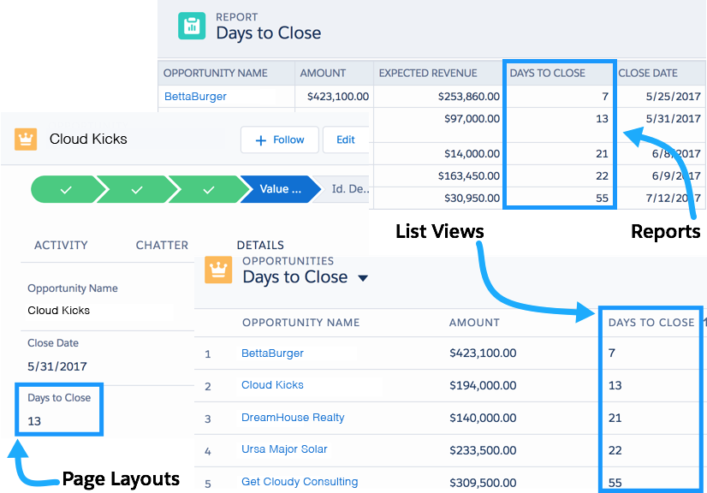
Formulas and Validations

Slide 19
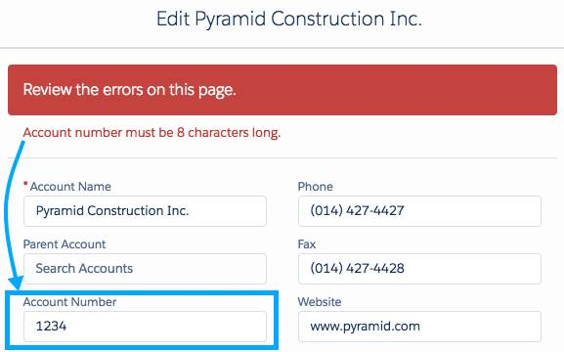
Formulas and Validations
Validation Rules

Slide 20

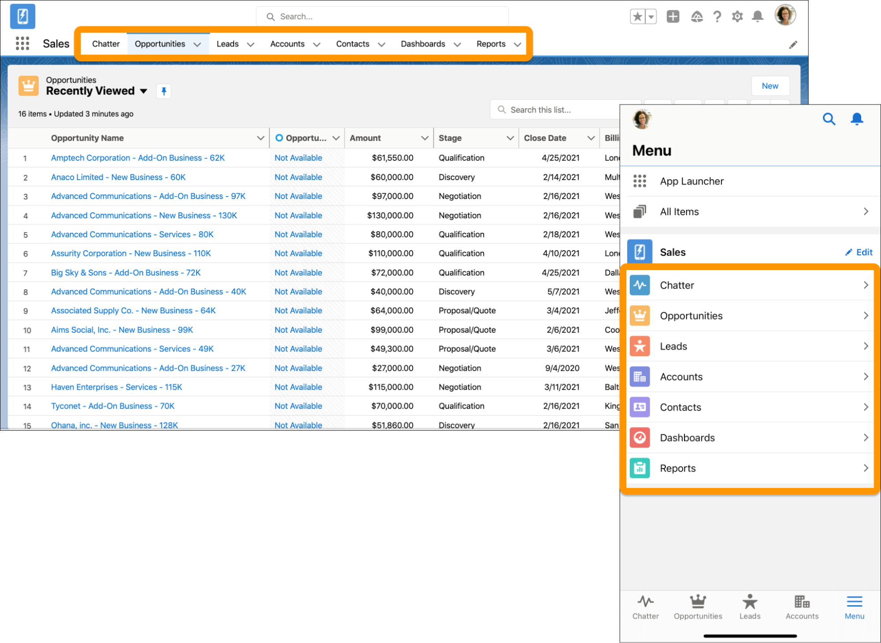
Salesforce Mobile App Customization
Customize navigation

Slide 21
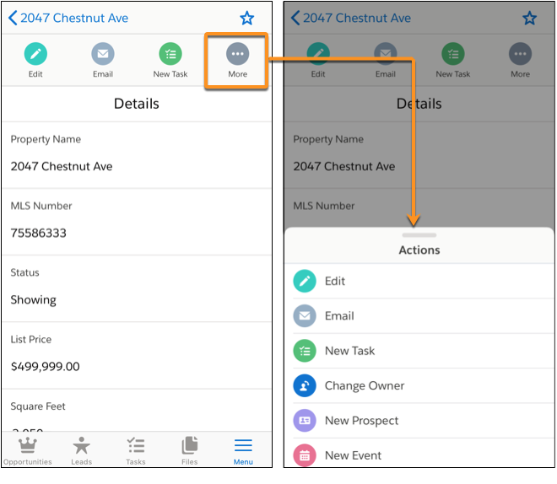
Salesforce Mobile App Customization
Customize quick actions and object-Specific Quick Actions

Slide 22
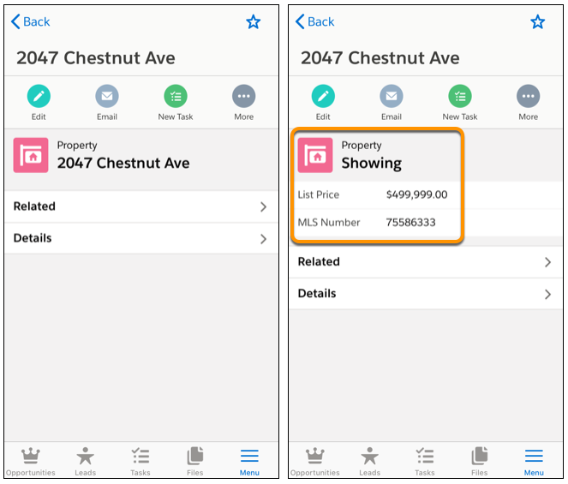
Salesforce Mobile App Customization
Customize compact layouts

Slide 23

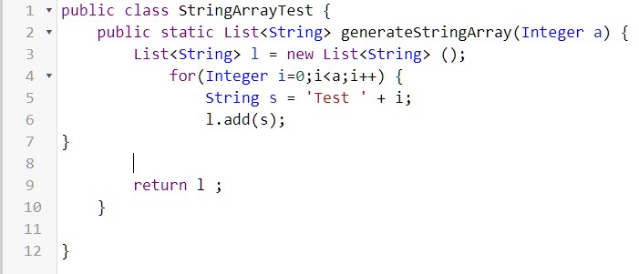
Apex Basics & Database
Create and execute Apex classes

Slide 24
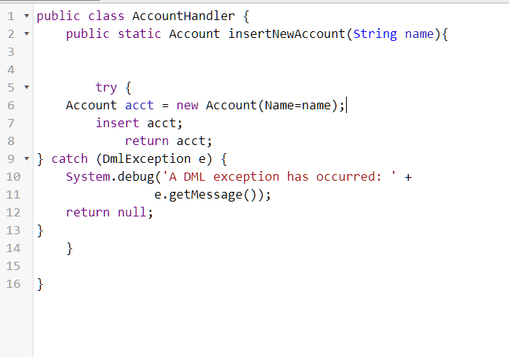
Apex Basics & Database
Use and handle sObjects

Slide 25
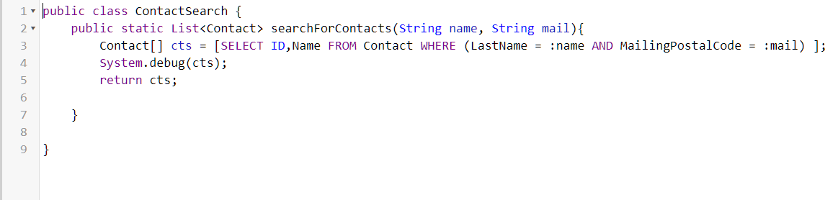
Apex Basics & Database
Write SOQL Queries

Slide 26
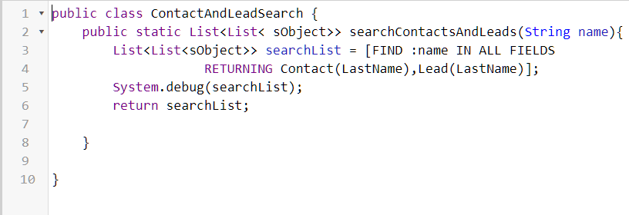
Apex Basics & Database
Write SOSL Queries

Slide 27

THANKS!
Do you have any questions?

